Slide 1
Working with ORC / hive tables
Working with Spark SQL to query Hive Managed Table (in Orc Format); ORC or parquet is famous choice for the storage for the performance advantages.
for instance: sc.hadoopConfiguration.set("orc.stripe.size", "268435456")
sqlContext.setConf("spark.sql.orc.filterPushdown", "true")
d
saveAsTable
https://orc.apache.org/docs/hive-config.html
https://www.slideshare.net/Hadoop_Summit/performance-update-when-apache-orc-met-apache-spark-81023199
https://databricks.com/blog/2015/07/16/joint-blog-post-bringing-orc-support-into-apache-spark.html
https://jaceklaskowski.gitbooks.io/mastering-apache-spark/spark-sql-Optimizer-PushDownPredicate.html
How to track JIRa
https://issues.apache.org/jira/browse/ZOOKEEPER-2950?jql=

Slide 2
What IS ORC ?
ORC is a self-describing type-aware columnar file format designed for Hadoop ecosystem workloads. The columnar format lets the reader read, decompress, and process only the columns that are required for the current query
As ORC is one of the primary file formats supported in Apache Hive, users of Spark’s SQL and DataFrame APIs will now have fast access to ORC data contained in Hive tables.
sc.parallelize(records).toDF().write.format("orc").save("people") val people = sqlContext.read.format("orc").load("people") people.registerTempTable("people")
Column Pruning
without reading the contacts column from the file system, and thus speeds up read performance:ORC saves IO bandwidth by only touching required columns, and requires significantly fewer seek operations because all columns within a single stripe are stored together on disk.
The columnar nature of the ORC format helps to avoid reading unnecessary columns. However, we are still reading unnecessary rows even if the query has WHERE clause filter
ORC is able to avoid this type of overhead by performing predicate push-down with its build-in indexes.
By default, ORC predicate push-down is disabled in the Spark SQL and need to be explicitly enabled:
sqlContext.setConf("spark.sql.orc.filterPushdown", "true")
Partition pruning is another optimization method that can avoid reading large amounts of data by exploiting query semantics.
Spark supports saving data out in a partitioned layout seamlessly, through the partitionBy method available during data source writes.
person.write.format("orc").partitionBy("age").save("peoplePartitioned")
results.write.format("orc").save("yahoo_stocks_orc")

Slide 3
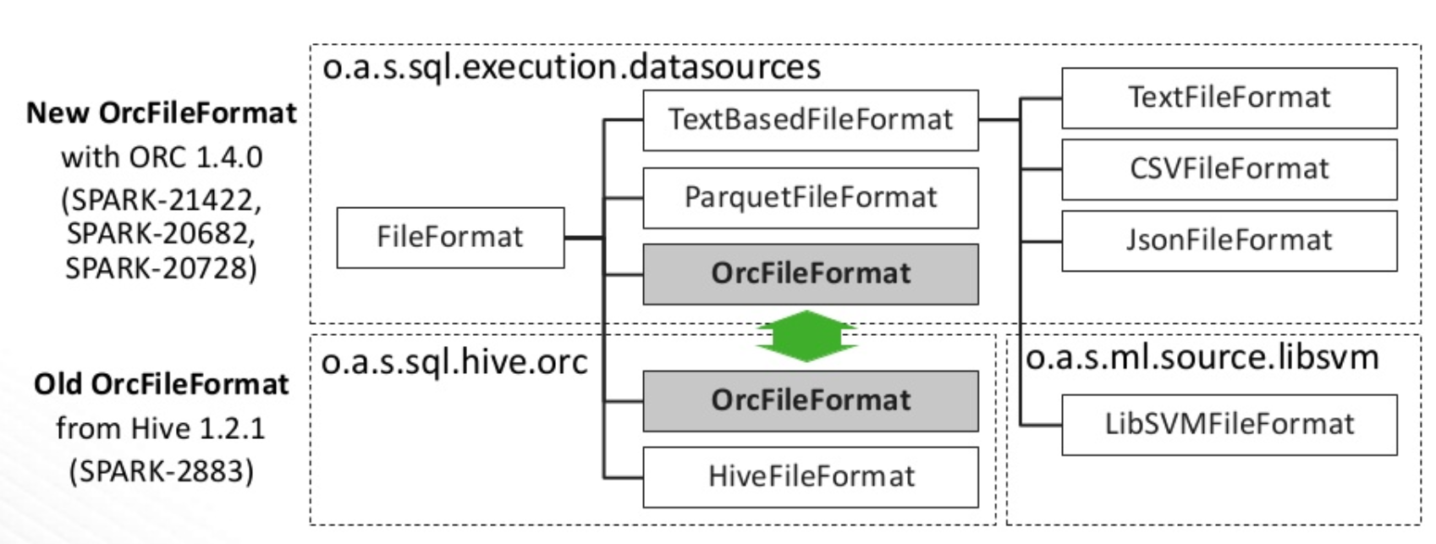

Slide 4
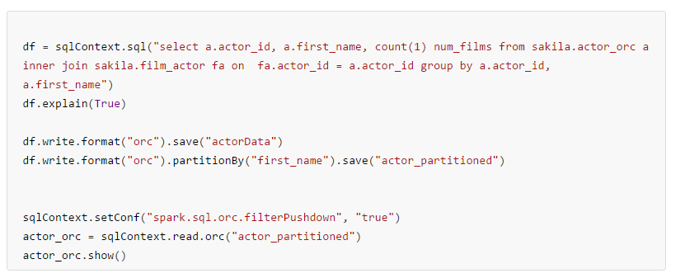
https://spark.apache.org/examples.html

